Slide 1


Slide 2
Agenda
Problem Statement 03
Data Mining - 01 04
Data Mining - 02 05
Exploratory Data Analysis (EDA) 06
Data Visualization 07
Algorithms Used 08
Analysis of Results 09
Conclusion & Future Work 10

Slide 3
Problem Statement
The objective of this project is to build a predictive model that provide approval results for individual credit card application. Using the customer's application record and their past credit record to effectively predict suitability..
The model should take into account various variables such as age,salary, age, Debt, Years employed,Bank customer or not and other relevant features available in the dataset.
In this project, we aim to develop a machine learning model that can predict whether the Credit is Approved or not with the following criteria.

Slide 4
Data Mining-01
Firstly the data set contains Different data types
conversion of variables into int data type with astype() function
The shape of the Data Set is 690, 16 (Rows , Columns)
There is one Duplicate row in the dataset we need to delete it.
After deleting the duplicate reset the row index
checking for null values,there are no null values in the dataset

Slide 5
Data Mining- 02
The size of data set becomes 689*16 as we deleted one row.
Converting categorical variables into numerical variables as ML model can take only numerical values.
conversion is done with the help of Label Encoder.
The given data is Balanced one with proportion 1.24:1
There is no need to delete any variable in the dataset because all are influencing target variable(HeartDisease)

Slide 6
Exploratory Data Analysis (EDA)
In the dataset the target variable is “Approved” because our machine learning model is to predict whether the credit card is approved or not.
I considered all remaining variables as independent because they are influencing target variable ine some way.
After identifying the target variable we can split the data set into train and test data by using sklearn train_test_split() method
After dividing the dataset into train and test, train data is used to train the model algorithms and test data is used to test the accuracy of the model algorithms

Slide 7
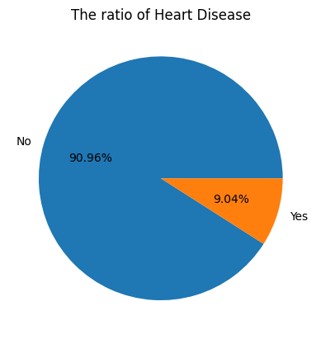
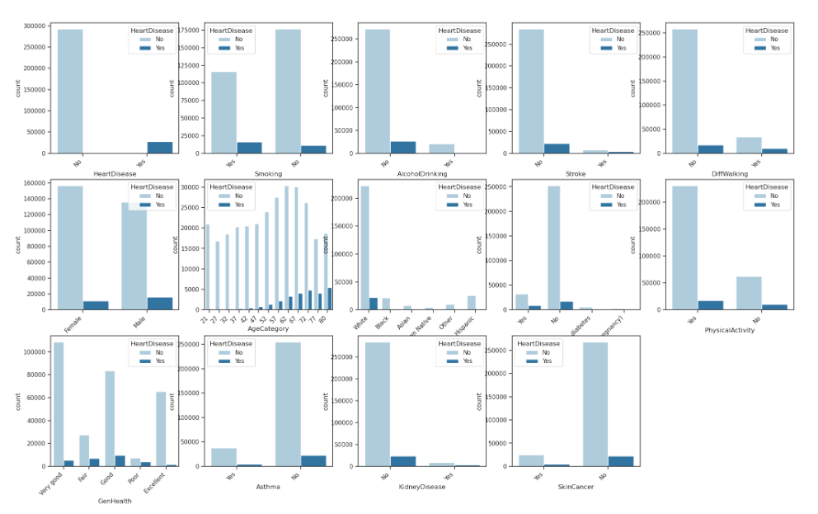
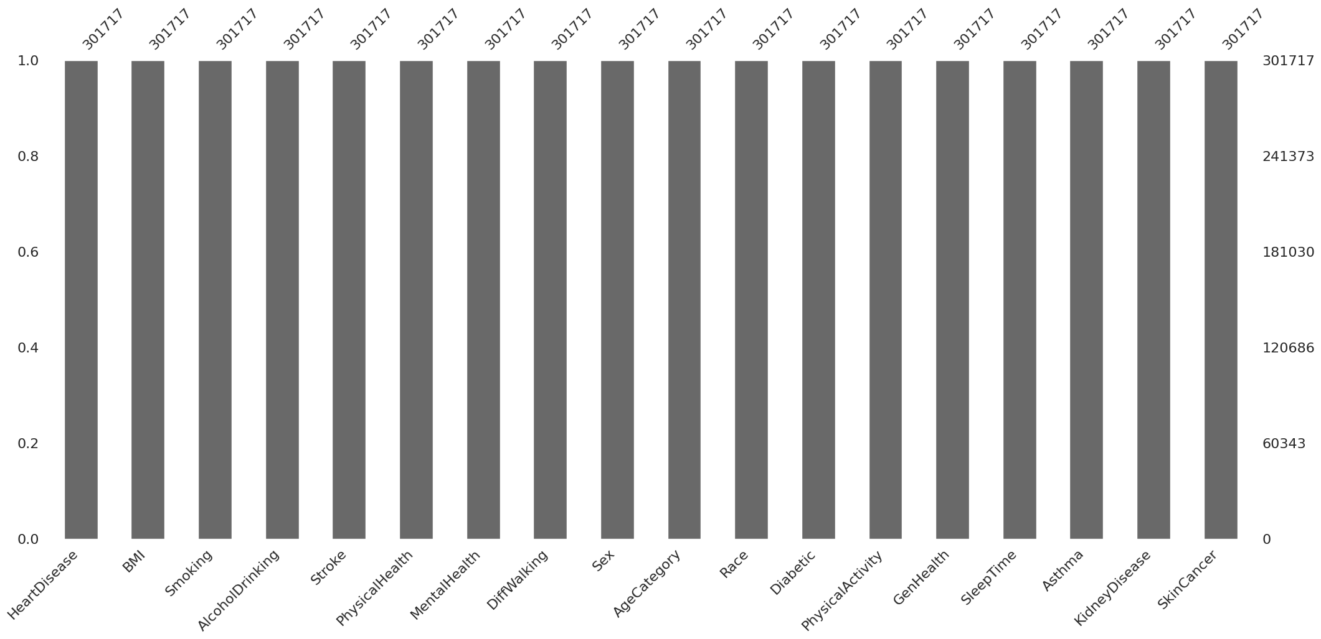
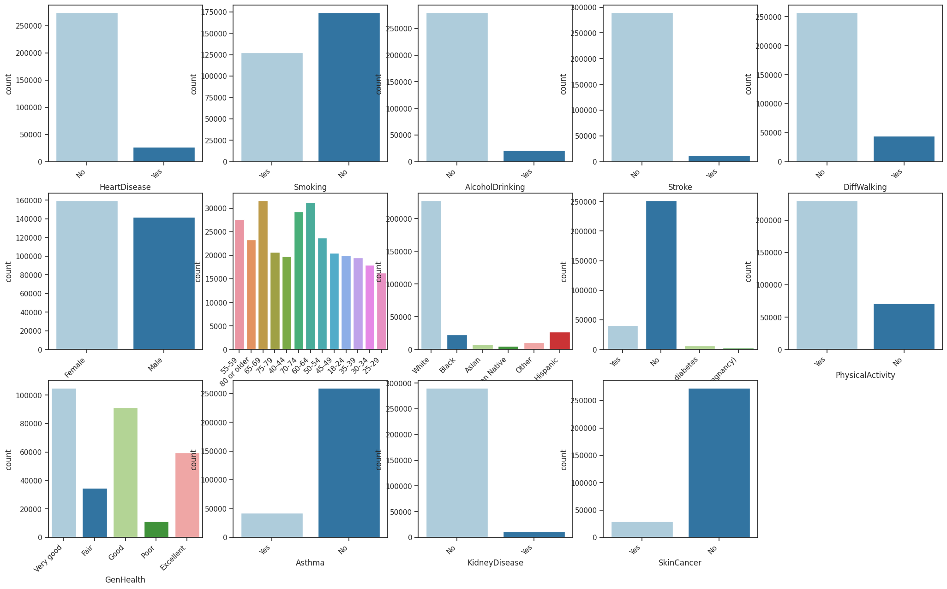
Data Visualization

Slide 8
Algorithms Used
It is a classification problem
There are total seven algorithms in classification problems
Logistic Regression
Decision Tree Classification
Random Forest
Extra Trees Classification
KNN Algorithm
SVM Algorithm
Naïve Bayes Algorithm
Among 7 algorithms, Decision works best for this problem .

Slide 9
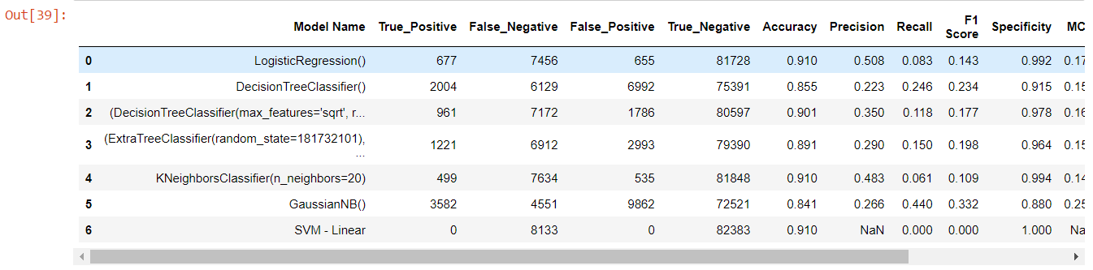
Conclusion and Future Work
After evaluating various algorithms, we have found that K-Nearest Neighbors (KNN) achieves the highest accuracy among them
Therefore, we will utilize the KNN algorithm to predict the presence of Heart Disease in our model

Slide 10
Thank You
Q & A
Student Name : Sai Marikanti
Roll Number : 21B91A54A4
SRKR Engineering College
Mobile: +91 9347531606
Email: 21b91a54a4@srkrec.ac.in
Bhimavaram - India

